Slide 1
A Nation’s Happiness
Beau Batchelor
Sherry Jystad
Dustin Markan
Julie Nguyen

Slide 2
Scope
We wanted to test, what we considered to be, the leading factors of happiness amongst different nations.
We found a list that was compiled from the Gallop World Poll that asked “How would you rate your happiness on a scale of 0 to 10 where 10 is the happiest“ and used this as a basis. (Found on Kaggle)
Then we each took a category to test and broke down the question further.

Slide 3
The categories we looked at:
Economy
GDP per Capita
Gini Coefficient
Health
Expected Years of Healthy Life
Education
Literacy percentage
Crime
Prison Rate

Slide 4
Our motivation:
To find the best way to increase the happiness of people everywhere.
Isn’t that sweet of us?

Slide 5
Economy
Data:
World Bank
GDP per Capita
Gini Coefficient

Slide 6
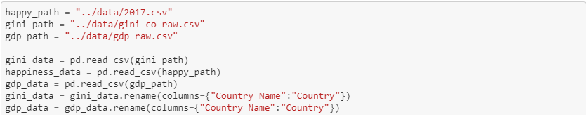
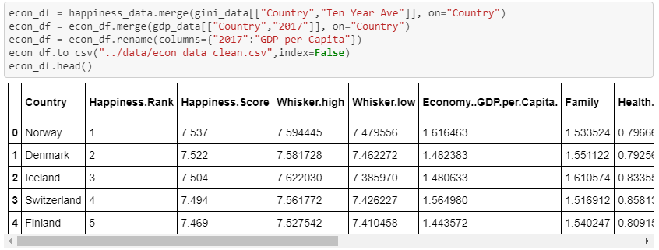
Economy
Exploration and Clean up:

Slide 7
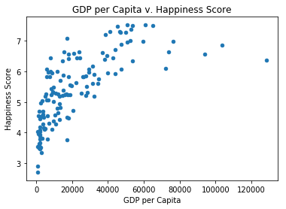
Economy

Slide 8
Economy
None of the top five highest GDP per capita nations are in the top ten happiest.
 | GDP Per Capita | Happiness Score
Qatar | 128,378.30 | 6.375
Columbia | 14,552.00 | 6.356

Slide 9
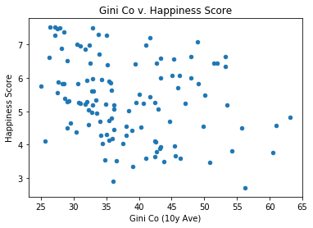
Economy

Slide 10
Health
Data:
UN World Happiness Report

Slide 11
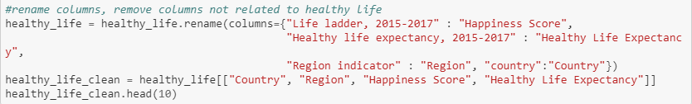
Health
Exploration and Clean up:

Slide 12
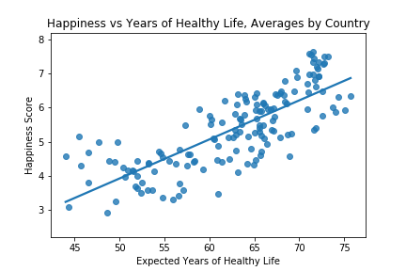
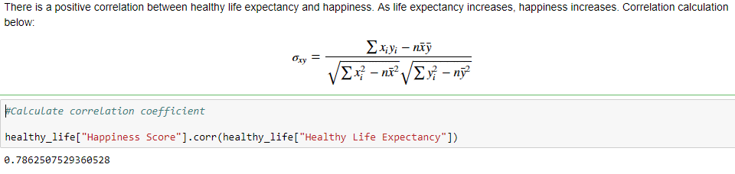
Health

Slide 13
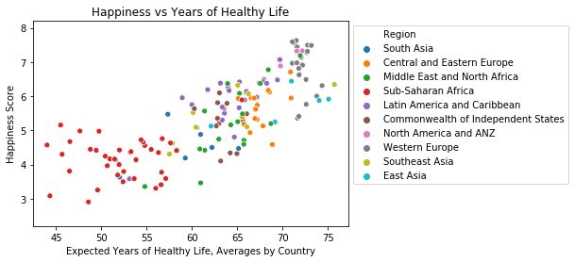
Health

Slide 14
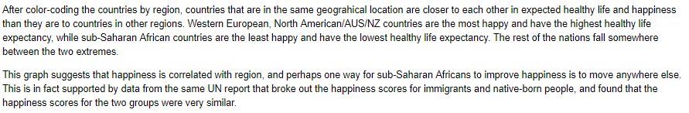
Conclusions

Slide 15
Education
Data:
World Atlas
Unesco

Slide 16
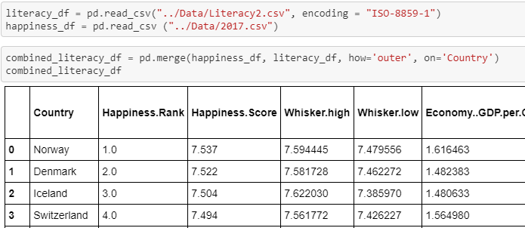
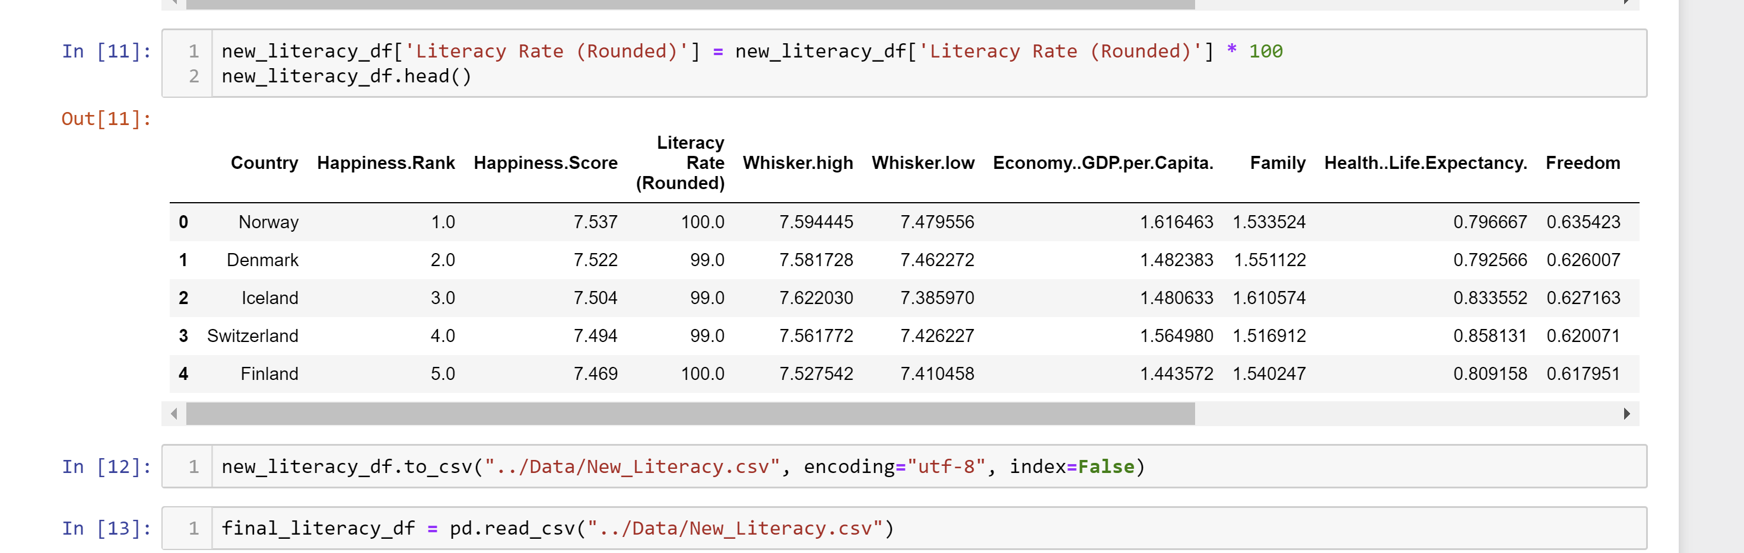
Education
Exploration and Clean up:

Slide 17
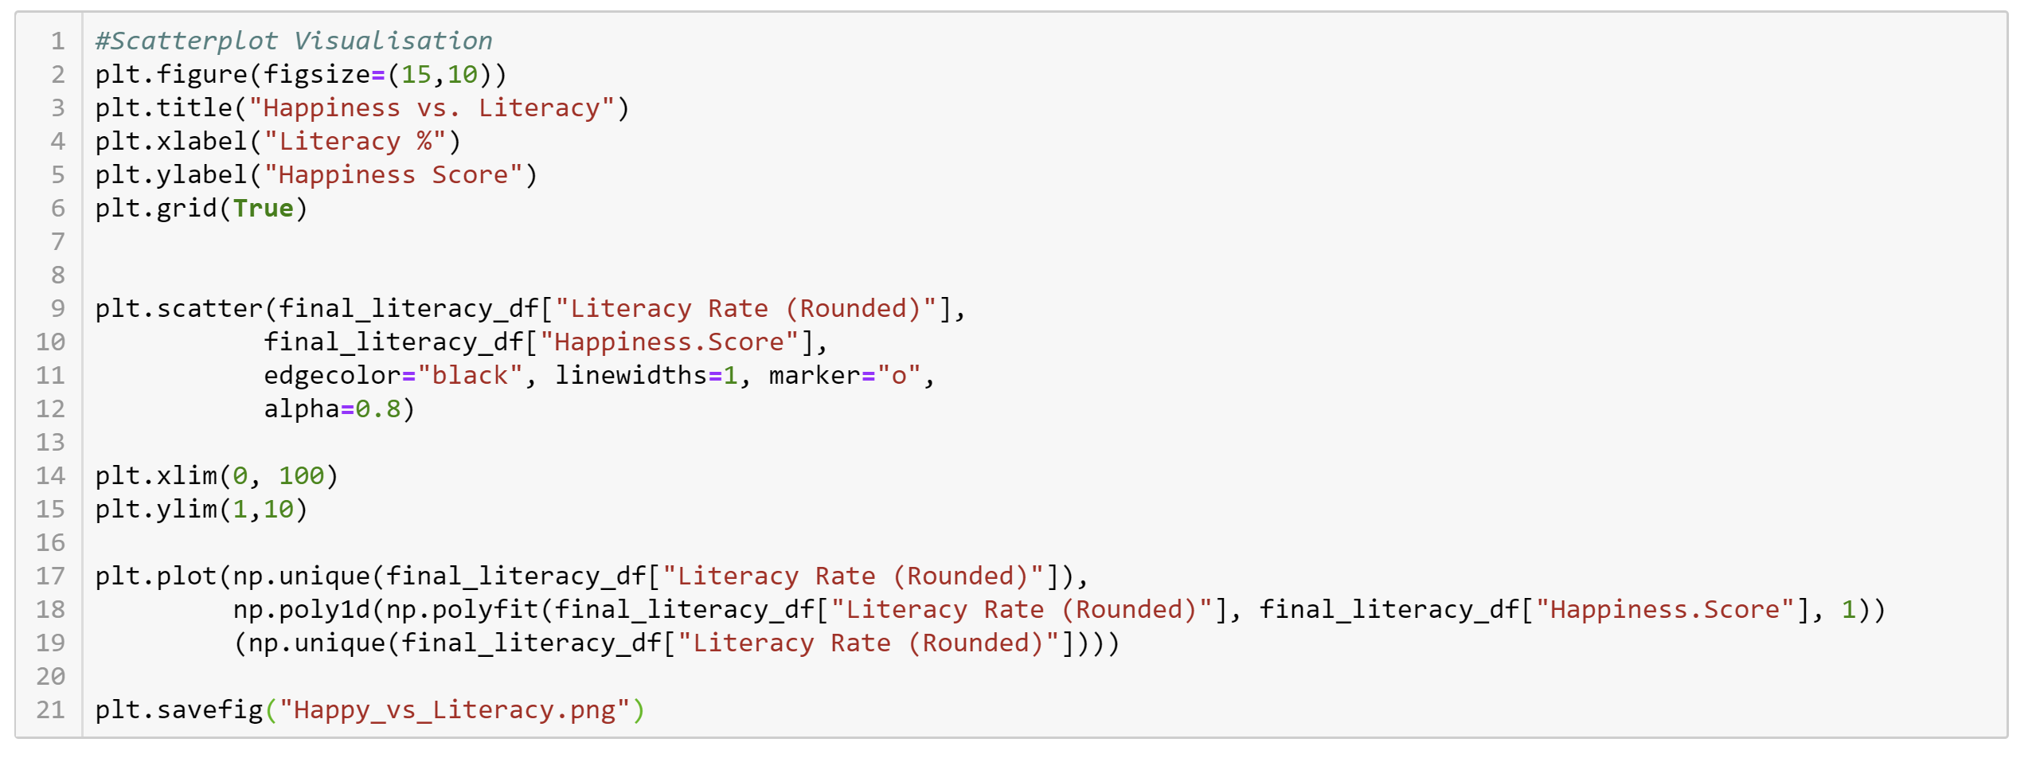
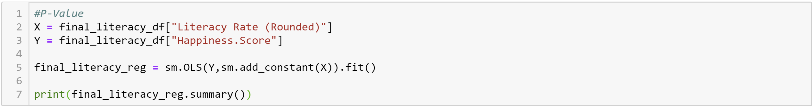
Education
Exploration and Clean up:

Slide 18
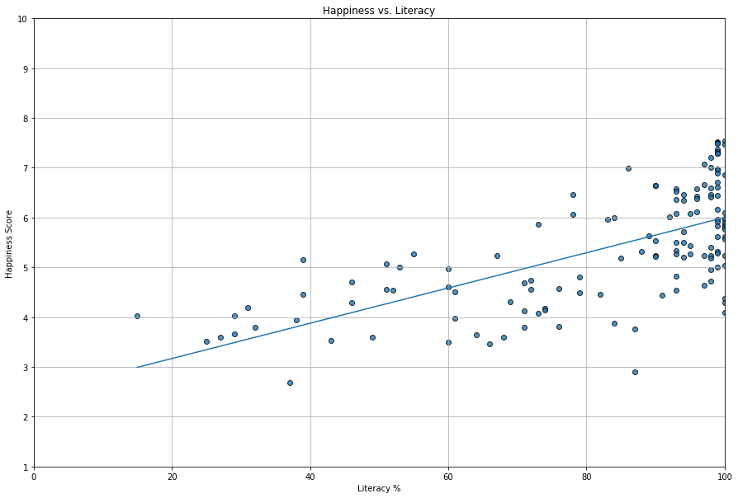
Education

Slide 19
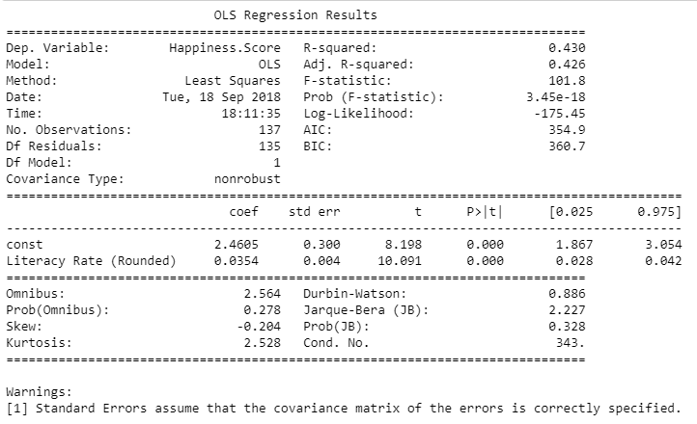
Education

Slide 20
Crime
Data:
United Nations Office on Drug and Crime

Slide 21
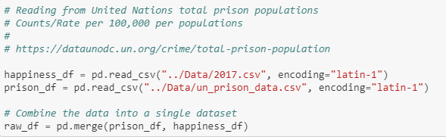

Crime
Exploration and Clean up:

Slide 22
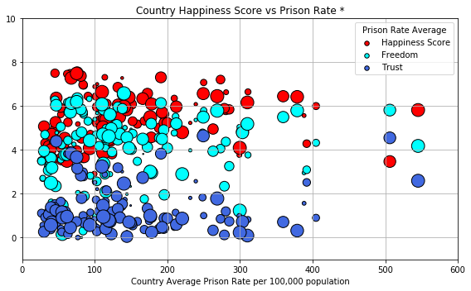
Crime

Slide 23
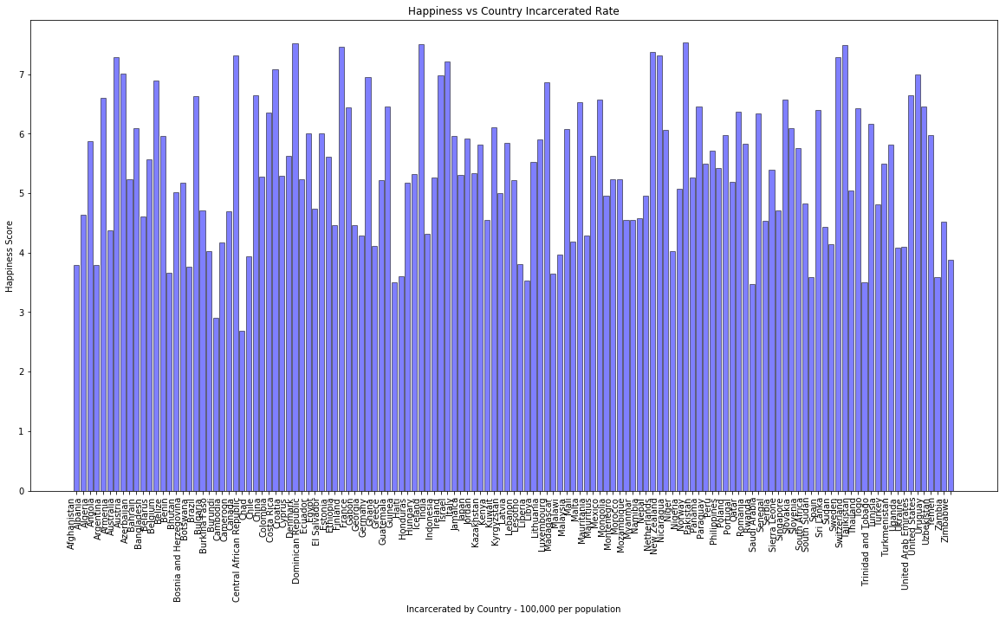
Crime

Slide 24
Limitations
The test of happiness is based on a questionnaire. The attitude of a wide range of individuals can sway based on sudden events or news.

Slide 25
Conclusions
-Happiness grows with a nation’s economy and literacy rate, but only to a certain point.
-Prison Rate has little affect on a nation’s happiness
-Length of Healthy life showed the most clear correlation to national happiness.

Slide 26
Conclusions
-Nations should not invest energy or money on incarceration rate and instead focus on industry, schooling, and health care.

